Slide 1






ARTIFICIAL
INTELLIGENCE
IN
PNEUMONIA
DETECTION

Slide 2

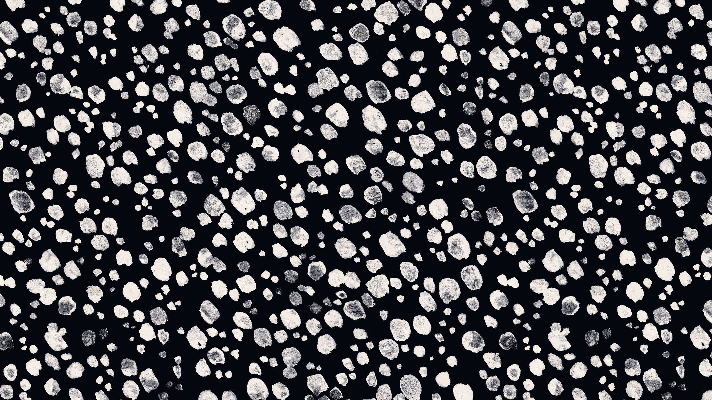
GUIDED BY -
PRESENTERS :-
Dr . Arpita Gupta mam
V. VIDYASRI - 2010030534
N. VAISHNAVI - 2010030537
K. DEEPTHISRI - 2010030450
K. NANDINI - 2010030385

Slide 3

TABLE OF CONTENTS
Abstract
Problem Statement
Data Sets Information
Project Area
Literature Survey
Conclusion
Thank you

Slide 4
ABSTRACT
Artificial intelligence has found its use in various fields during the course
of its development, especially in recent years with the enormous increase in available data. Its main task is to assist making better, faster and more reliable decisions. Artificial intelligence and machine learning are increasingly finding their application in medicine. This is especially true for medical fields that utilize various types of biomedical images and where diagnostic procedures rely on collecting and processing a large number of digital images. The application of machine learning in processing of medical images helps with consistency and boosts accuracy in reporting. Our project describes the use of machine learning algorithms to process chest X-ray images in order to support the decision making process in determining the correct diagnosis. Specifically, the research is focused on the use of deep learning algorithm based on convolutional neural network in order to build a processing model. This model has the task to help with a classification problem that is detecting whether a chest X-ray shows changes consistent with pneumonia or not, and classifying the X-ray images in two groups depending on the detection results.

Slide 5
PROBLEM STATEMENT
The goal is to build a pneumonia detection system to locate the position of inflammation in image. Even for trained Radiologists, it is a challenging task to examine chest x – ray images. There is a need to improve diagnosis accuracy. So the aim of our project is to design an intelligence system that receives x – ray images of the lungs as an input parameter and based on the processed image, detects the possibility of pneumonia as an output. We want to build an algorithm to automatically identify whether a patient is suffering with pneumonia or not by looking into the chest x – ray images. We want to make this algorithm extremely accurate because lives of people is at stake. For this project, an efficient model for detection of pneumonia trained on digital chest x – rays is proposed, which acts as an aid for radiologists in their decision making process. X – ray images which are used for diagnosis of pneumonia need expert radiotherapists for evaluation. Thus developing an automatic system for detecting pneumonia would be beneficial for treating the disease without any delay particularly in remote areas.

Slide 6
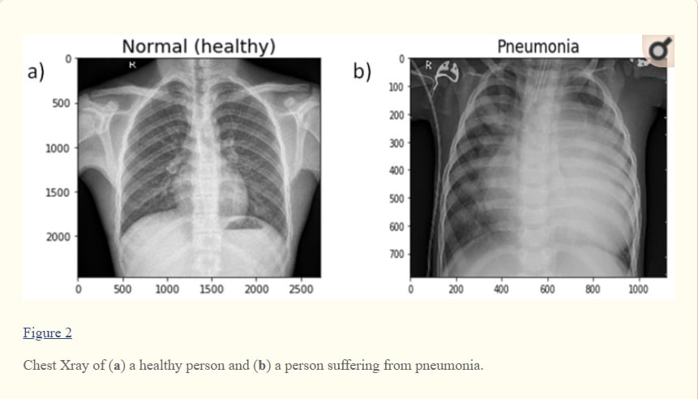
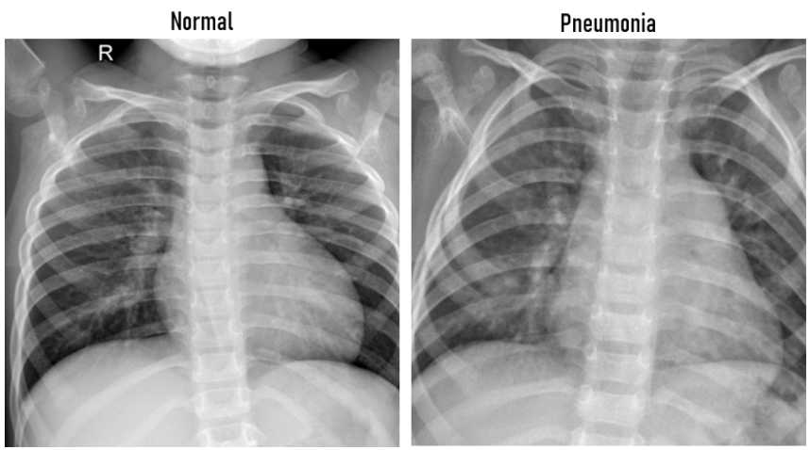
DATA SETS INFORMATION
The dataset composes of two classes which are normal lung and pneumonia lung as can be seen in the figure below.

Slide 7
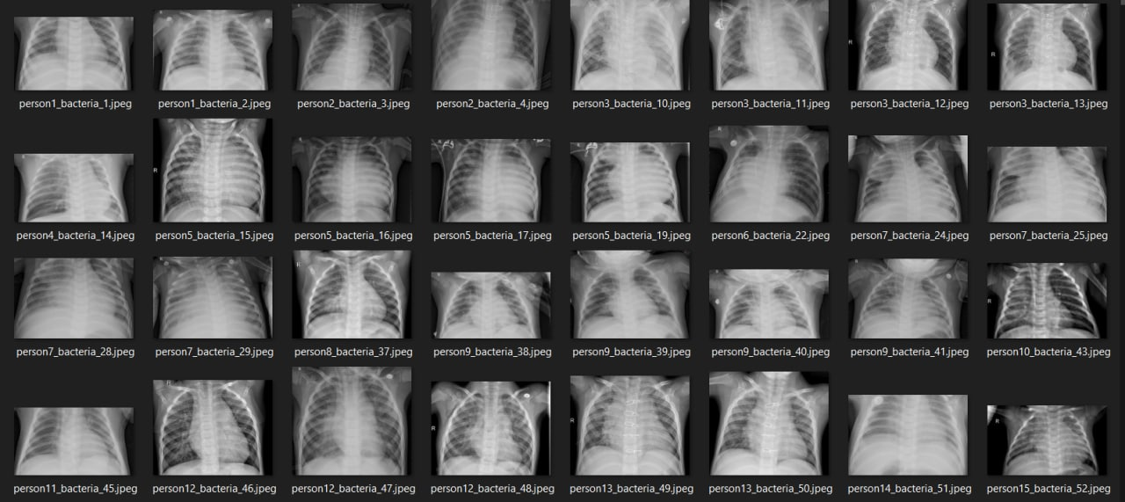

Slide 8

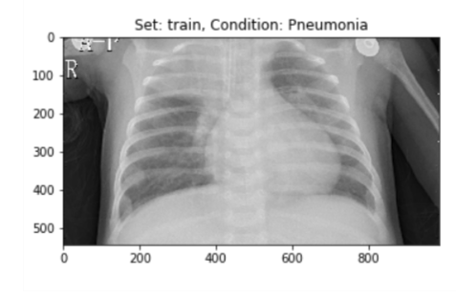
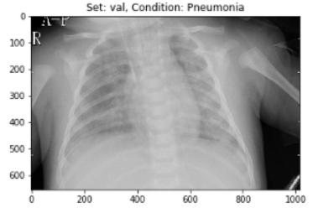
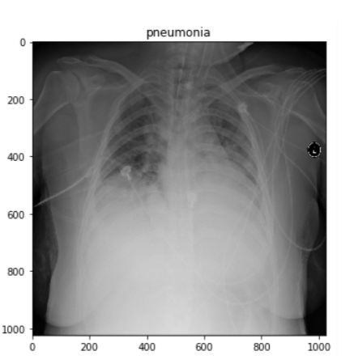
PNEUMONIA DETECTED X - RAYS :

Slide 9
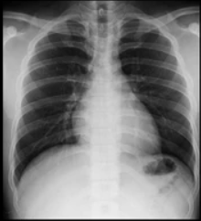
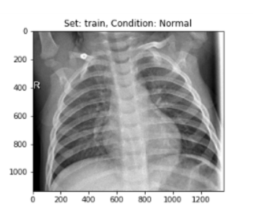
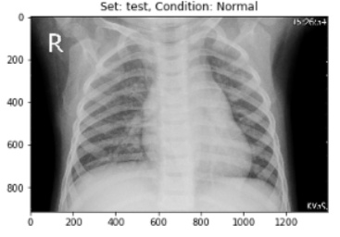
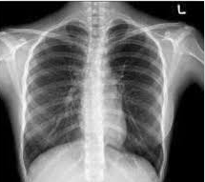
PNEUMONIA NOT DETECTED X - RAYS :

Slide 10
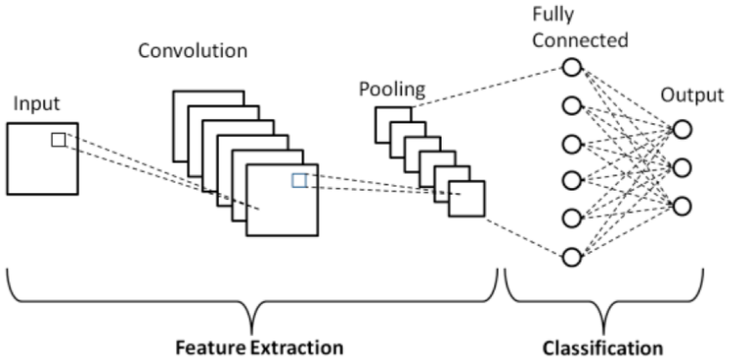
Convolutional Neural Network
Although we see images with color and shapes, in their most basic level they are lists of numbers, each number corresponding to an RGB value which is then
processed by your computer to show you the image. Convolutional neural networks have gained traction in image processing because they are able to split the RGB array into (1x1), (2x2), or (3x3) pixels in order to learn patterns within an image

Slide 11
DOMAIN AND SUB – DOMAIN ( project area )
COMPUTER VISION :-
A computer vision is a branch of computer science that empowers machine to see, recognize and process images just like humans. It is a field that includes methods of acquiring, processing, analyzing, and understanding images . Examples of this
technology include image recognition, visual recognition, and facial recognition.
IMAGE CLASSIFICATION :-
Image classification is the process of predicting a specific class, or label, for something that is defined by a set of data points. Image classification is a subset of the classification problem, where an entire image is assigned a label.

Slide 12

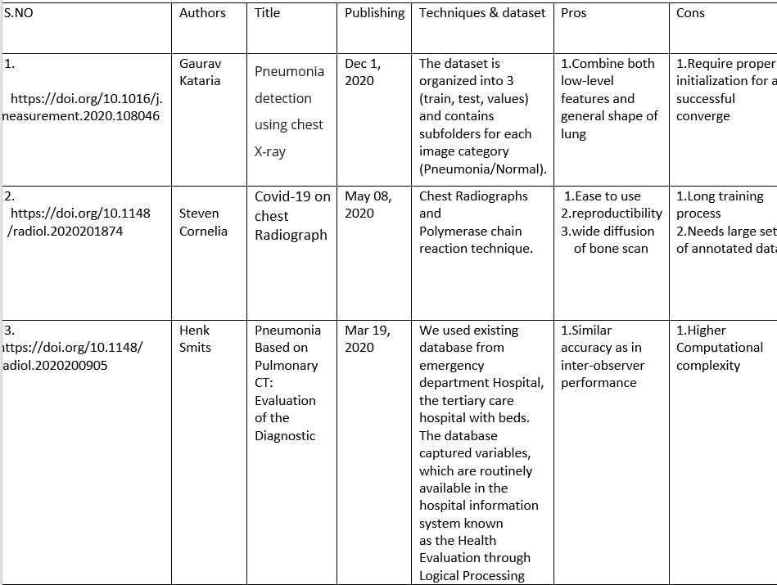
LITERATURE SURVEY

Slide 13
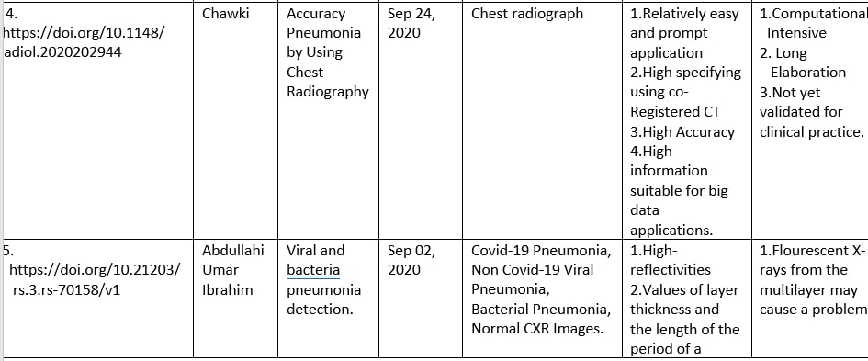

Slide 14
CONCLUSION
Early detection of pneumonia is crucial for determining the appropriate treatment of the disease and preventing it from threatening the patient’s life. Chest radiographs are the most widely used tool for diagnosing pneumonia; however, they are subject to inter-class variability and the diagnosis depends on the clinicians’ expertise in detecting early pneumonia traces. To assist medical practitioners, an automated CAD system was developed in this study, which uses deep transfer learning-based classification to classify chest X-ray images into two classes “Pneumonia” and “Normal.”
It describes the use of deep learning in order to classify digital images of chest X-rays according to presence or absence of changes consistent with pneumonia.
The implementation was using Python programming and scientific tools.

Slide 15


